Slide 1



CREDIT CARD FRAUD DETECTION
Team Members: Parth Mehta Guide: Jay Rathod
Abizer Popat
Nauman Khokhar
Harsh Khandelwal
Disclaimer: The content is curated for educational purposes only.

Slide 2
OUTLINE
Abstract
Problem Statement
Aims, Objective & Proposed System/Solution
System Design/Architecture
System Development Approach (Technology Used)
Algorithm & Deployment
Conclusion
Future Scope
References
Video of the Project
Notes:
These are the list of chapters that we are going to cover in these foundation codes. Those are chapter one what are AI and ML? chapter 2 applied Python programming in AI, and chapter 3 is exploratory data analysis for ML.

Slide 3
Abstract
Due to increase of fraud which results in loss of money across the globe, several methodologies and techniques developed for detecting frauds. Fraud detection involves analysing the activities of users in order to understand the malicious behaviour of users ,Malicious behaviour is a broad term including delinquency, fraud, intrusion, and account defaulting. This paper presents a survey of current techniques used in Credit Card Fraud Detection fraud detection and evaluates a new hybrid approach to identify fraud detection. In the proposed work, we analyze Credit Card Fraud Detection fraud detection using machine learning algorithm namely logistic regression. To make the learning process efficient, we used principal component for feature selection.

Slide 4
Problem Statement
The exponential growth of online transactions has unfortunately been accompanied by a surge in Credit Card Fraud Detection fraud. Fraudsters employ increasingly sophisticated tactics, making it challenging for traditional rule-based systems to keep pace. This poses a significant financial burden on both financial institutions and consumers.
Current challenges in Credit Card Fraud Detection fraud detection using traditional methods include:
High dimensionality and complexity of transaction data, making it difficult to identify subtle patterns indicative of fraud.
Imbalanced datasets, where fraudulent transactions represent a tiny fraction of all transactions, hindering model training for fraud detection.
Evolving nature of fraud, with fraudsters constantly adapting their techniques, requiring models to be continuously updated.

Slide 5
Aim and Objective
Aim:
The Aim of Credit Card Fraud Detection fraud detection is to create a secure and trustworthy financial environment for both issuing banks and cardholders. This is achieved by minimizing the financial losses caused by fraudulent transactions.
Objectives:
Prevent fraudulent transactions: Identify and block unauthorized card usage before any financial loss occurs.
Minimize customer inconvenience: Reduce the number of false positives (declining legitimate transactions) to ensure a smooth user experience for genuine cardholders.
Reduce financial losses: Protect both issuing banks and cardholders from financial losses associated with fraudulent activities.
Enhance customer trust: By proactively combating fraud, card issuers can build stronger customer trust and loyalty.
Identify emerging fraud trends: Continuously monitor and adapt to evolving fraudster tactics to maintain an effective defense.

Slide 6
Proposed Solution
1. Data Collection and Preprocessing
Gather historical transaction data including amount, location, time, merchant category, and user demographics (with privacy precautions).
Preprocess the data by handling missing values, outliers, and categorical features. Feature engineering might be necessary to create new informative features.
2. Machine Learning for Anomaly Detection
Utilize ML algorithms like Isolation Forest or Local Outlier Factor (LOF) to identify transactions deviating significantly from a user's regular spending patterns. This can flag high-value purchases, transactions from unusual locations, or activities outside typical spending times.
3. Deep Learning for Pattern Recognition
Implement a Deep Neural Network (DNN) like a Long Short-Term Memory (LSTM) network to analyze sequences of transactions. LSTMs can identify fraudulent patterns like multiple small purchases followed by a large one, or transactions originating from geographically impossible locations within a short time span.
4. Model Selection and Ensemble Learning
Train and evaluate multiple models, including ML classifiers like Random Forest or Gradient Boosting, and the DNN.

Slide 7
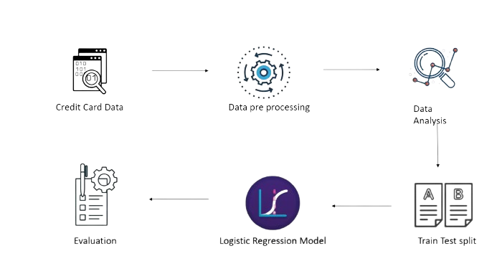
System Architecture

Slide 8
System Deployment Approach
1. Development and Testing Environment:
Set up Development Environment
Develop and Train Models
Model Evaluation and Selection
Testing and Refinement
2. Staging and Integration
Prepare Staging Environment
Develop Integration logic
Security Measures
3. Production Deployment:
Gradual Rollout
Deployment and Monitoring
Alert Management
4. Continuous Improvement
Model Retraining and Feedback Loop
Performance Optimization
Regulatory Compliance

Slide 9
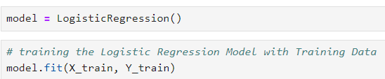
Algorithm & Deployment
Logistic Regression:-
Binary outcome: Logistic regression works best when you have a dependent variable with two categories, like yes/no, pass/fail, or spam/not spam.
Probability prediction: Instead of directly classifying something as 0 or 1, it predicts the likelihood of it belonging to one of the classes (typically between 0 and 1).

Slide 10
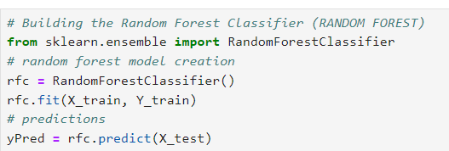
2. Random Forest:-
Ensemble of decision trees: Random forests build a collection of decision trees, like a forest. Each tree makes its own prediction based on the data.
Strength in numbers: The final prediction is made by combining the outputs of all the trees, often through majority vote (classification) or averaging (regression). This reduces reliance on any single tree's potential biases.

Slide 11
Conclusion
In conclusion, Credit Card Fraud Detection fraud detection has become increasingly important due to the rise of online transactions. AI, ML, and DL offer powerful tools to combat this issue. By combining these techniques, you can build a robust system that analyzes transaction patterns, identifies anomalies, and flags suspicious activity in real-time.
The proposed system architecture provides a modular and scalable solution for deployment. The development and deployment approach emphasizes rigorous testing, security measures, and continuous monitoring to ensure optimal performance and user protection.

Slide 12
Future Scope
The future of AI-powered Credit Card Fraud Detection fraud detection is brimming with exciting possibilities that aim to not only catch fraud but prevent it entirely.
Unsupervised Learning: Moving beyond just labeled data (fraudulent vs. legitimate transactions), unsupervised learning algorithms can find hidden patterns in vast datasets. This can unearth new fraud typologies and connections that supervised learning might miss.
Graph Neural Networks (GNNs): These models can analyze the connections between users, merchants, and transactions. This network analysis can reveal fraudulent rings, identify suspicious merchant clusters, and track stolen card usage across different accounts.
Federated Learning: This approach allows training models on user devices without compromising sensitive data. This can be particularly valuable for distributed data sources or real-time fraud detection on mobile wallets.
Explainable AI (XAI): While AI models excel at identifying fraud, XAI techniques can help us understand why a transaction is flagged. This transparency builds trust with users and allows analysts to identify weaknesses exploited by fraudsters.
Biometric Authentication: Integrating fingerprint, voice, or facial recognition into the authentication process can add an extra layer of security, especially for high-value transactions.
Real-time Intervention: Instead of simply flagging transactions, future systems might prompt users for confirmation during suspicious activity, potentially preventing fraud attempts altogether.

Slide 13
Reference
http://www.oreilly.com/data/free/the-new-artificial-intelligence-market.csp
https://gemini.google.com/app/dfca426a7e9c30d7
https://www.geeksforgeeks.org/ml-credit-card-fraud-detection
https://www.mdpi.com/2504-2289/8/1/6
Project 10. Credit Card Fraud Detection using Machine Learning in Python | Machine Learning Projects (youtube.com)
Notes:
Reference
These are the references for this session.
13

Slide 14
Drive link:
https://drive.google.com/drive/folders/1mEiiCfQd9IalJuNx_9SshqEtps-BAFaX

Slide 15
Thank you!
Notes:
thank you very much for joining this PPT, keep learning.
15

